Slide 1

H6751 Text & Web Mining
Group Project
Job & Candidate Resume Matching Solution
-> Determine what kind of positions does your resume match<-
Luo Shuang, Wang Sixin, Zhao Hengrui, Xia Xiaolong

Slide 2


Presentation Flow
INTRODUCTION
Problem Statement
Data Preparation
Data Description
Mining Process Flow
CLUSTERING
Data preprocessing
Clustering method
CLASSIFICATION
Model training
Comparison of Results
SUMMARY & MORE…
Discussion and Limitation

Slide 3


Problem Statement
Initiative
79% of the job seekers utilized the online resources for their most recent employment.(Aaron, 2015)
On average, 250 resumes are received for each job opening by the major organizations, more than 50% of the resumes does not meet the minimum requirement
The traditional online job board does not seem to simplify the job application process or reduce the effort required from both parties.
Objective
Develop a machine learning model to accelerate the job - resume matching process.
Problem Statement
Data Description
Methodology & Implementation
Experimental Results
Conclusions

Slide 4
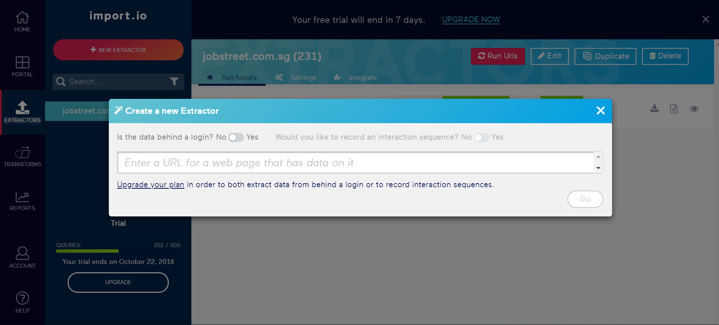


Data Preparation
Crawling Resources and Tool
Job Posting Resource
Resume Resource
Web Crawling Tool
Target HTML Tags
Jobstreet.sg: id=“position_title”, id=“job_description”
Indeed.com.sg: id=“resume_body”
Problem Statement
Data Description
Methodology & Implementation
Experimental Results
Conclusions

Slide 5
Data Preparation
Datasets
Training Dataset (Job Postings in Singapore from Jobstreet.sg)
(453 job postings)
Testing Dataset (Resumes from indeed.com.sg)
(84 resumes)
Target Features
Job title, job description and job requirement from job posting, and the working experience, education, skills from resume.
Download to Excel, CSV or NDJASON
Problem Statement
Data Description
Methodology & Implementation
Experimental Results
Conclusions

Slide 6
Raw Data Description
Datasets
Company background, working culture and other non-core information are mixed up
Amounts of HTML/CSS/JavaScripts codes are embedded within the text(both job postings and resumes)
Word overlaps are obvious among all job postings, such as “job”, “role”, “position”, which may interfere performance of accurate clustering (being filtered in the RapidMiner)
There are certain word overlaps between job postings and resumes, which is possible for using resumes as test set
Data Cleanup
Remove irrelevant information
Remove HTML/CSS/JavaScripts codes
Problem Statement
Data Description
Methodology & Implementation
Experimental Results
Conclusions

Slide 7
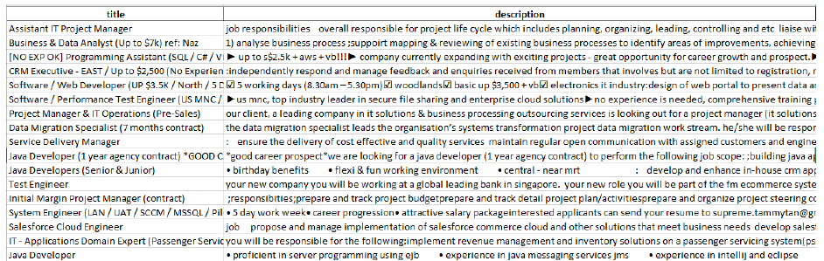
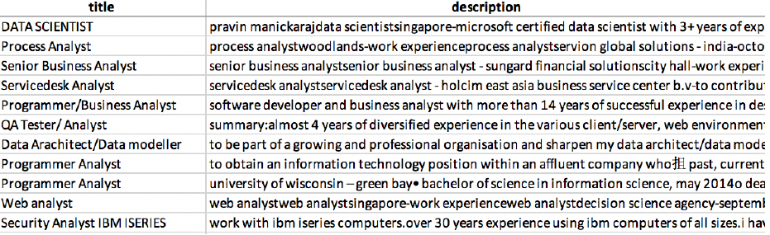
Final Data Set
Job Posting
Title (Position Title)
Description (merged by job description and job requirement, roles and responsibility)
Resume
Title (The position applied by the resume)
Description (Candidate’s experience, education and skills are merged into a single column as “description”)
Problem Statement
Data Description
Methodology & Implementation
Experimental Results
Conclusions

Slide 8

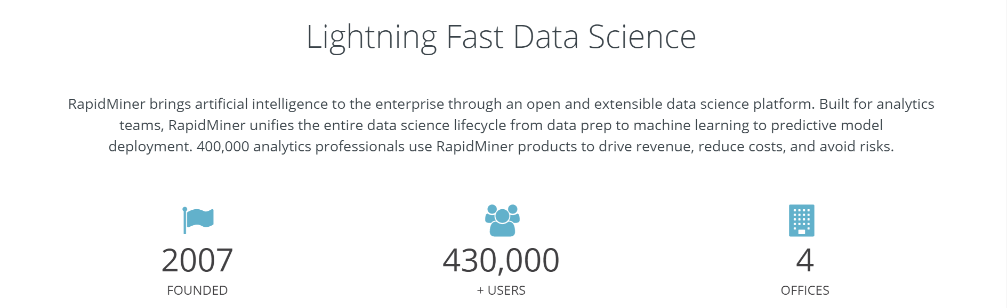
Text Mining Tool
RapidMiner
GUI based data mining software which specialized in text mining, machine learning, data preparation, and predictive analytics
Compare to many other data mining software, “RapidMiner” is much easier to install, configure and use
Problem Statement
Data Description
Methodology & Implementation
Experimental Results
Conclusions

Slide 9
High Level Process Flow
Break down into 4 major steps
Cluster and label each position in the unlabelled job posting dataset by k-Means clustering. (try out several clustering methods and choose the best-performed one)
In order to ensure efficiency of later classifier, tuning work is applied to the clustered labels
Use labelled job posting dataset as training dataset to train a classification model
Use the labelled resume dataset to test the model and evaluate its performance
Problem Statement
Data Description
Methodology & Implementation
Experimental Results
Conclusions

Slide 10
Preprocessing Unlabelled Data
Preprocessing Data
Tokenize + Filter Stopwords (English) + Filter Tokens(Dictionary) + Filter Tokens(lengths) + Stem(Porter) + Transform Cases + Generate n-grams
Problem Statement
Data Description
Methodology & Implementation
Experimental Results
Conclusions

Slide 11
Clustering
Clustering the Unlabelled Job Posting Dataset
The objective of this step is to assign label to each job posting through clustering process
We try for 3 clustering methods: k-Means clustering, EM clustering and DBSCAN
Cluster Distance Performance and Cluster Density Performance are used to evaluate. It turns out k-Means made best balance of performance and efficiency
Problem Statement
Data Description
Methodology & Implementation
Experimental Results
Conclusions

Slide 12
Clustering
Determine the best “k”
Furthermore, we drill down into k-Means and try to further improve clustering performance
Performance is also evaluated on the comparison between clustered outcome and later tuning outcome
We predefine different number of clusters and find out k=4 brings best outcome
Problem Statement
Data Description
Methodology & Implementation
Experimental Results
Conclusions

Slide 13
Clustering
Assign label to cluster
Transform cluster number (i.e.‘Cluster_3’) to nominal name (i.e. ‘developer’)
Labelled data set is stored as the training data set for the classification process
Cluster Distance Perfoance and evaluate performance each clustering process
Problem Statement
Data Description
Methodology & Implementation
Experimental Results
Conclusions

Slide 14
Classification
training set with labels
# Labelled job data
test set
actual training set
Job Posting
Resume
validation(test) set
model training
test-
model evaluation
test- submission file
Model
Problem Statement
Data Description
Methodology & Implementation
Experimental Results
Conclusions

Slide 15
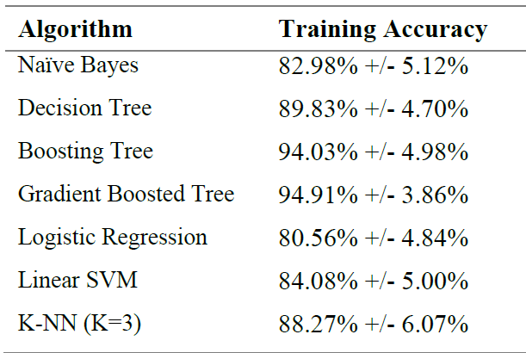
Classification
Training process
In the training process, we use the training data file generated from the previous step to perform classification based on the label assigned by clustering process
We apply several algorithms to train the model and use the 10-Fold Cross-Validation to evaluate the prediction accuracy
Problem Statement
Data Description
Methodology & Implementation
Experimental Results
Conclusions

Slide 16
Classification
Testing process
In the testing process, we use the resume dataset we pre-processed in the previous step to test the performance of trained models
Problem Statement
Data Description
Methodology & Implementation
Experimental Results
Conclusions

Slide 17
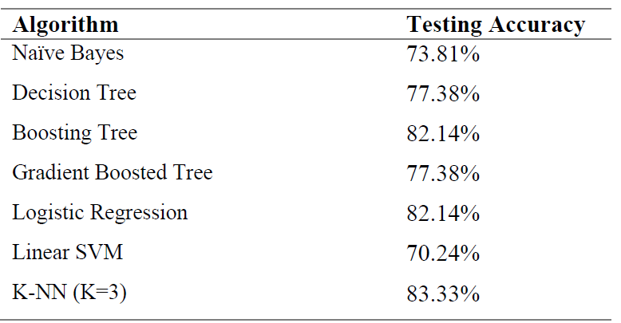
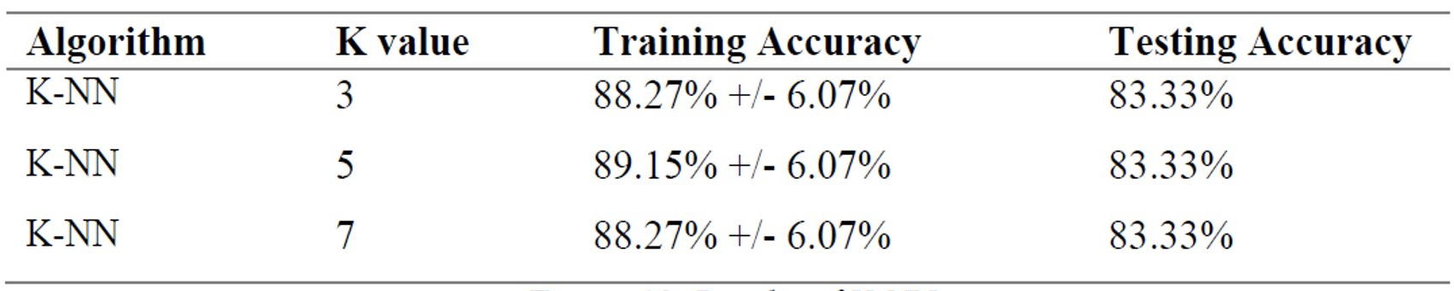
Test Result
Test result
K-NN yields rather good training accuracy and testing accuracy
It turns out when K=5, both training and testing performance reach best outcomes
Problem Statement
Data Description
Methodology & Implementation
Experimental Results
Conclusions

Slide 18
Conclusions

Slide 19
Discussion and Limitation
Discovery
When job titles are included in the text, clustering performance is greatly improved. It suggested title context are highly distinguishable and essential for job clustering.
Though elementary, k-Means still works best among all clustering methods. It balances performance and time efficiency.
Filter words dictionary is important to this case. Job posting contents have amounts of same/overlaps, so do resumes. So, using filter words dictionary helps to accelerate clustering efficiency.
Limitation
The sample size is relatively smaller than the total records of job website, which may not be sufficient to cluster and train a model with generalization strength
Another big challenge is the text length, for instance, text becomes quite lengthy after merged from the job requirement and job description in job posting dataset. Lengthy contents are time-consuming and memory-consuming when we run clustering, which forces us to cut down initial number of job postings. The behavior may suggest that to generalize the process in a much bigger database, we may need more resources to support the computation
Problem Statement
Data Description
Methodology & Implementation
Experimental Results
Conclusions

Slide 20

Thank you!

